Slide 1
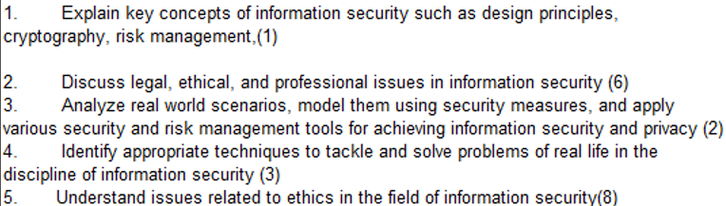
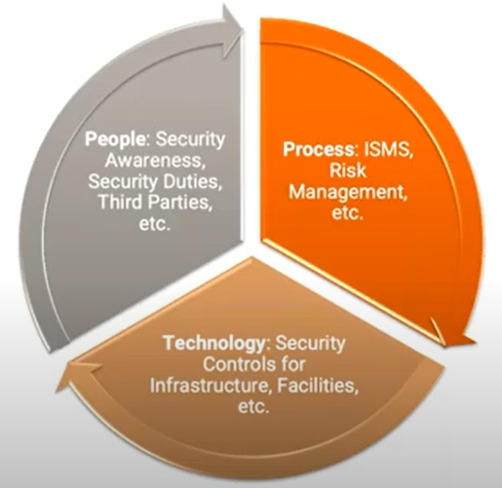
CS 3002 Information Security
Fall 2024
Week # 5 – Lecture # 16 and 17
25^{h} – 26th September 2024
24th MID -1 Exams
Dr. Aqsa Aslam

Slide 2
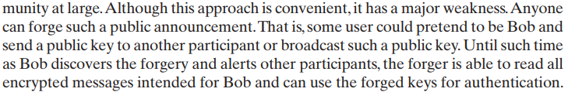
of the public key.

Slide 3
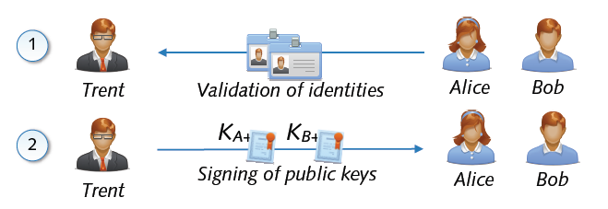
Public Key and Signatures
Problem: Public keys not linked to identity of user
Solution: Validation and signing of public key by third party
Certification of link between identity and public key
Acceptance of signed public keys only → no MITM attack

Slide 4

Public Key Certificates
Electronic document that uses a digital signature to bind a public key with an identity
Information such as the name of a person or an organization, their address, and so forth.
The certificate can be used to verify that a public key belongs to an individual.
Two Types of Signature on a Certificate
In public key infrastructure (PKI) scheme
Signature will be of a certificate authority (CA).
In web of trust scheme
Signature is of either the user (a self-signed certificate) or other users ("endorsements").
In either case, the signatures on a certificate are attestations by the certificate signer that the identity information and the public key belong together.
*from wiki

Slide 5
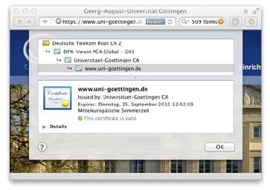
Public Key Infrastructure (PKI)
Public-key infrastructure (PKI) is a set of hardware, software, people, policies, and procedures needed to create, manage, distribute, use, store, and revoke digital certificates.
Management of trust using public-key cryptography
Digital certificates (signatures) on keys, attributes, ...
Certificate authorities (CA) as trusted parties
Chain of trust with multiple layers
Different architectures
Hierarchical PKI,
e.g. X.509 standard
Web of trust,
e.g. PGP software

Slide 6
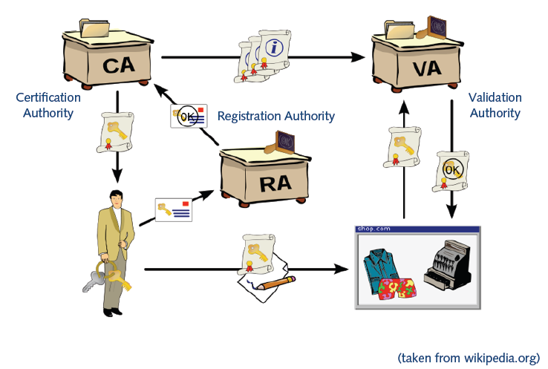
Roles In PKI
*from wiki

Slide 7
Roles In PKI
Certification Authority (CA)
Trusted third party that binds public keys with respective user identities
Validation Authority (VA)
The user identity must be unique within each CA domain. The third-party Validation Authority (VA) can provide this information on behalf of CA.
Registration Authority (RA)
The binding is established through the registration and issuance process, which, depending on the level of assurance the binding has, may be carried out by software at a CA, or under human supervision. The PKI role that assures this binding is called the Registration Authority (RA). The RA ensures that the public key is bound to the individual to which it is assigned in a way that ensures non-repudiation.
*from wiki

Slide 8
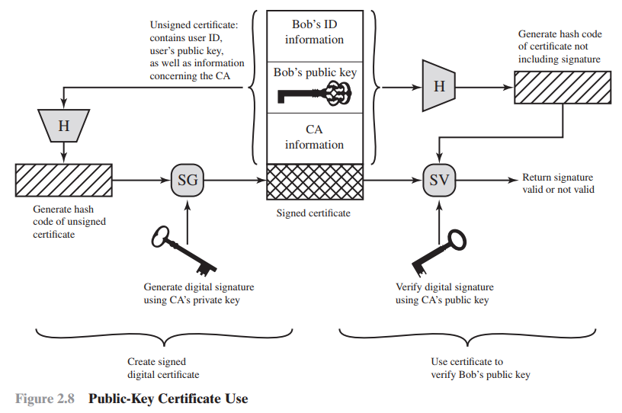

Slide 9
Public-Key Certificates
Left Side: Certificate Creation
Unsigned Certificate (Bob's information):
Contains Bob's ID, Bob's public key, and information about the Certificate Authority (CA).
Hashing (H):
A hash function generates a hash code from the unsigned certificate to ensure integrity (prevent alterations).
Signing (SG):
The hash code is signed using the CA’s private key, creating a digital signature for the certificate.
This process produces a signed digital certificate containing Bob's information and the CA's signature.
Right Side: Certificate Verification
Hashing (H):
To verify the certificate, the receiver generates a new hash from the unsigned portion of the certificate (excluding the signature).
Signature Verification (SV):
The signature is decrypted using the CA’s public key.
The decrypted signature is compared with the newly generated hash.
Validation:
If the hash matches the decrypted signature, the signature is valid, confirming that:
The certificate has not been altered.
Bob's public key is verified and trustworthy.
Summary:
Signing: The CA generates a hash of Bob’s certificate and signs it using its private key.
Verification: The receiver hashes the certificate and verifies the signature using the CA’s public key. If valid, Bob’s public key is trusted.

Slide 10
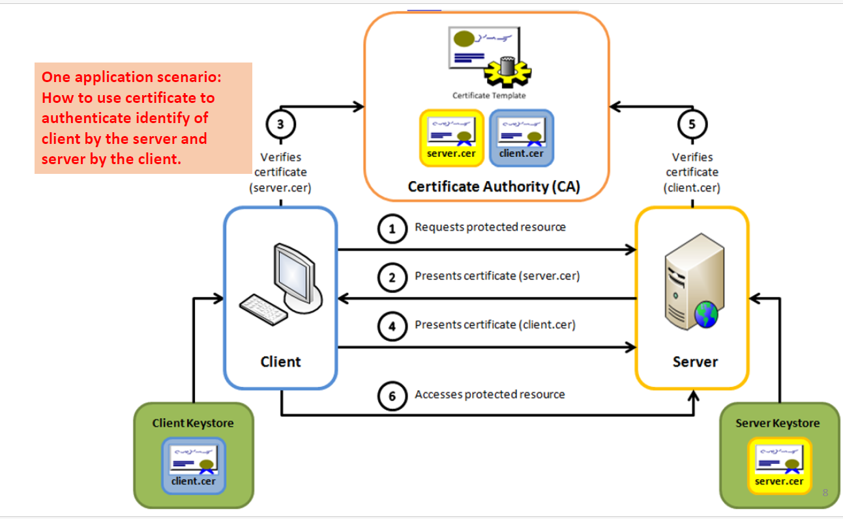

Slide 11
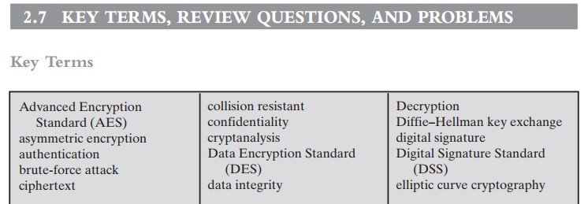
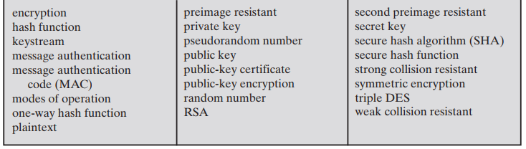

Slide 12
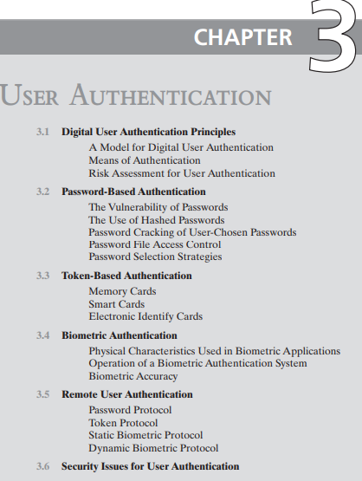
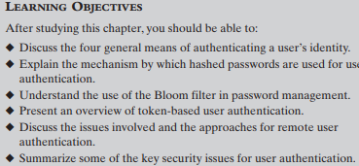

Slide 13
User Authentication
User authentication is a fundamental security building block
User authentication is the basis for:
Access control and User accountability
User authentication encompasses two functions
Identification: The user presents a credential (e.g., user ID) to identify themselves to the system.
Verification: The system verifies the user's identity through an exchange of authentication information (e.g., passwords, biometric data
Identification: The process by which a user provides a claimed identity to the system (e.g., presenting a user ID).
User Authentication: The method of establishing the validity of the claimed identity, typically through verification of credentials (e.g., passwords, biometric data).

Slide 14
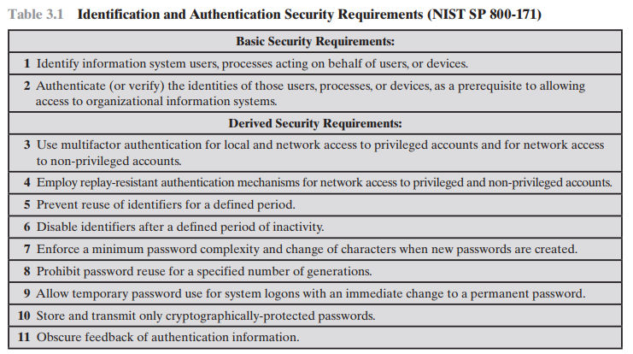

Slide 15
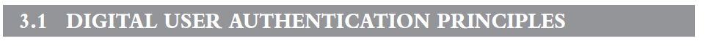
NIST SP 800-63-3 (Digital Authentication Guideline, October 2016) defines digital user authentication as the process of establishing confidence in user identities that are presented electronically to an information system.
Systems can use the authenticated identity to determine if the authenticated individual is authorized to perform particular function such as database transactions or access to system resources.

Slide 16
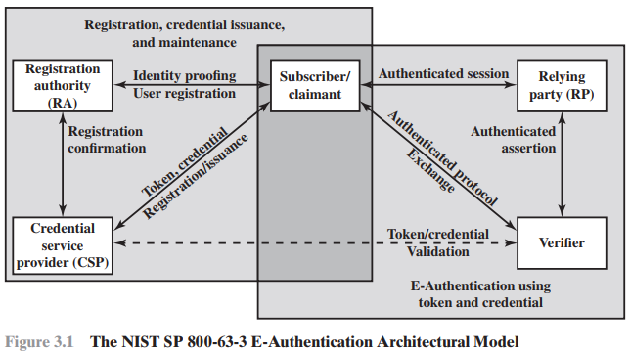
A Model for Digital User Authentication
User Registration: Applicant registers with the system via a trusted RA.
Credential Issuance: CSP issues an electronic credential linking identity to a token.
Claimant & Verifier:
Claimant: User to be authenticated.
Verifier: Confirms claimant’s identity.
Assertions & RP: Verifier sends identity assertion to RP. RP makes access or authorization decisions.

Slide 17
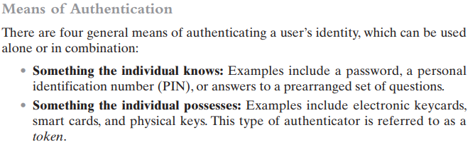

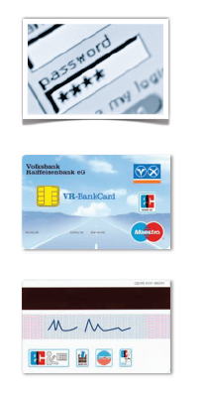
Example
Login to a computer
Authentication by knowledge (password)
Online debit cards
Authentication by ownership (card) and
knowledge (PIN)
Offline debit cards
Authentication by ownership (card) and
human factor (signature)

Slide 18

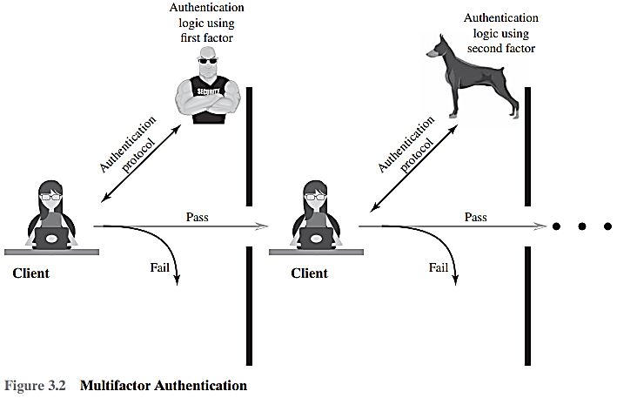
Multi-Factor Authentication
Multifactor authentication involves using more than one authentication method from different categories.
Implementations using two factors are stronger than single-factor authentication.
Systems incorporating three factors are stronger than those using only two.
As the number of factors increases, the strength of the authentication system improves.
Authentication using multiple factors
Example: Scene from the movie “Mission Impossible”
Ethan Hunt needs to
use a stolen chip card (ownership factor)
forge a fingerprint (human factor)
enter the terminal room (location factor)
enter a password (knowledge factor)

Slide 19
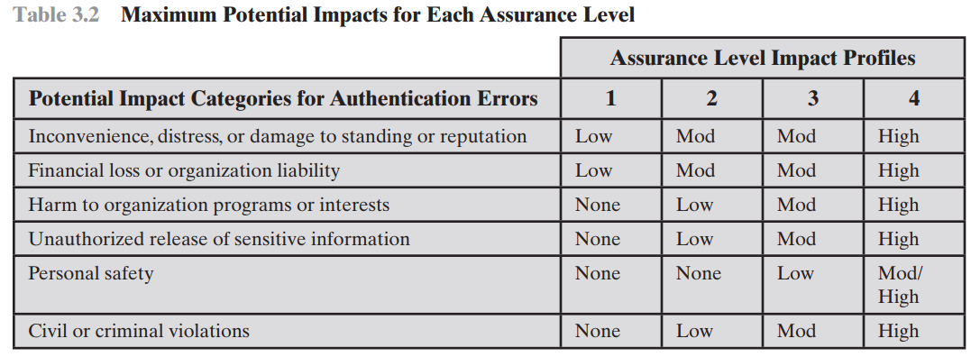
This table suggests a technique for doing risk assessment. For a given information system or service asset of an organization, the organization needs to determine the level of impact if an authentication failure occurs, using the categories of impact, or risk areas, that are of concern.
Read Assurance levels, Potential risk, Risk from the book

Slide 20
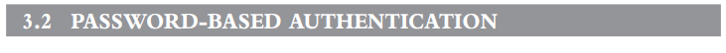
Attack strategies and countermeasure
Offline dictionary attack: Hackers access the system password file and compare password hashes.
Countermeasure: Use controls to prevent file access, intrusion detection, and rapid password reissuance.
Specific account attack: Repeated password guesses are used on a specific account.
Countermeasure: Account lockout after multiple failed attempts.
Popular password attack: Attackers use common passwords across various user IDs.
Countermeasure: Enforce policies that prevent the use of common passwords.
Password guessing (single user): Attackers guess based on known account details.
Countermeasure: Strong password policies including length, complexity, and periodic changes.
Workstation hijacking: Attacker exploits an unattended logged-in workstation.
Countermeasure: Automatic logout after inactivity and user behaviour monitoring.
Exploiting user mistakes: Users write down or share passwords.
Countermeasure: User training, detection systems, and better password management.
Exploiting multiple password use: Attackers use similar passwords across different systems.
Countermeasure: Enforce unique passwords for each system.
Electronic monitoring: Passwords intercepted during network transmission.
Countermeasure: Use encryption that doesn’t reuse the same password

Slide 21

Problems with Passwords
Password snooping
Eavesdropping of passwords in network traffic
Retrieval of passwords from hosts (e.g. via malware)
Password guessing (online) or cracking (offline)
Dictionary attacks = guessing using dictionary of words
Brute-force attacks = guessing using all possible strings
Human deficiencies
Weak and often re-used passwords

Slide 22
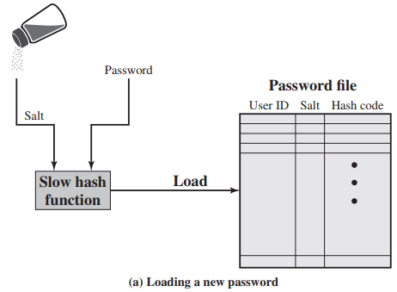
Widely Used Password Security Technique:
Combines hashed passwords with a salt value for enhanced security.
Commonly found in UNIX operating systems.
User selects or is assigned a password, which is combined with a fixed-length salt (random or pseudorandom values like time, date, etc.).
The hash algorithm is designed to be slow to prevent brute force and dictionary attacks.
The hashed password and plaintext salt are stored in the password file associated with the user ID.
This method is secure against various cryptanalytic attacks.

Slide 23
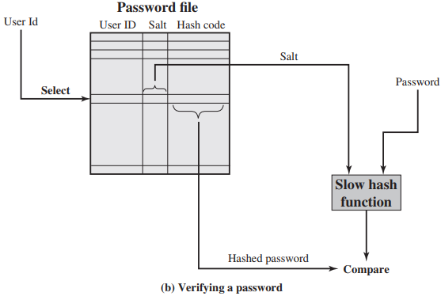
User Login Attempt: User provides a user ID and password.
Operating System Actions:
Uses the ID to index into the password file.
Retrieves:
Plaintext Salt: A random value for hashing.
Encrypted Password: The stored hashed password.
Password Verification:
Combines the salt with the user-supplied password.
Passes the combination through the encryption routine.
Result Comparison:
If the generated hash matches the stored encrypted password, access is granted; otherwise, it is denied

Slide 24
Why salt value?
Salt's Three Key Functions
Prevents duplicate password visibility in the password file by assigning unique salt values, even if users choose the same password.
Increases difficulty of offline dictionary attacks by multiplying the number of possible passwords by 2b, where b is the salt length in bits.
Makes it nearly impossible to determine if a user has reused the same password across multiple systems.

Slide 25
Traditional Password Cracking:
Develops a large dictionary of possible passwords.
Each password is hashed with various salt values and compared to stored hashes.
If no match, variations are tried (e.g., backward spelling, added numbers/special characters).
Rainbow Table Approach:
Precomputes potential hash values for a large dictionary of passwords.
Generates a massive table of hash values (rainbow table) for each salt value.
Example: Cracking 99.9% of alphanumeric Windows password hashes in 13.8 seconds using 1.4 GB of data.
Countermeasures:
Use sufficiently large salt values and hash lengths to defend against these attacks.
FreeBSD and OpenBSD methods are currently secure against this type of attack.

